Slide 1
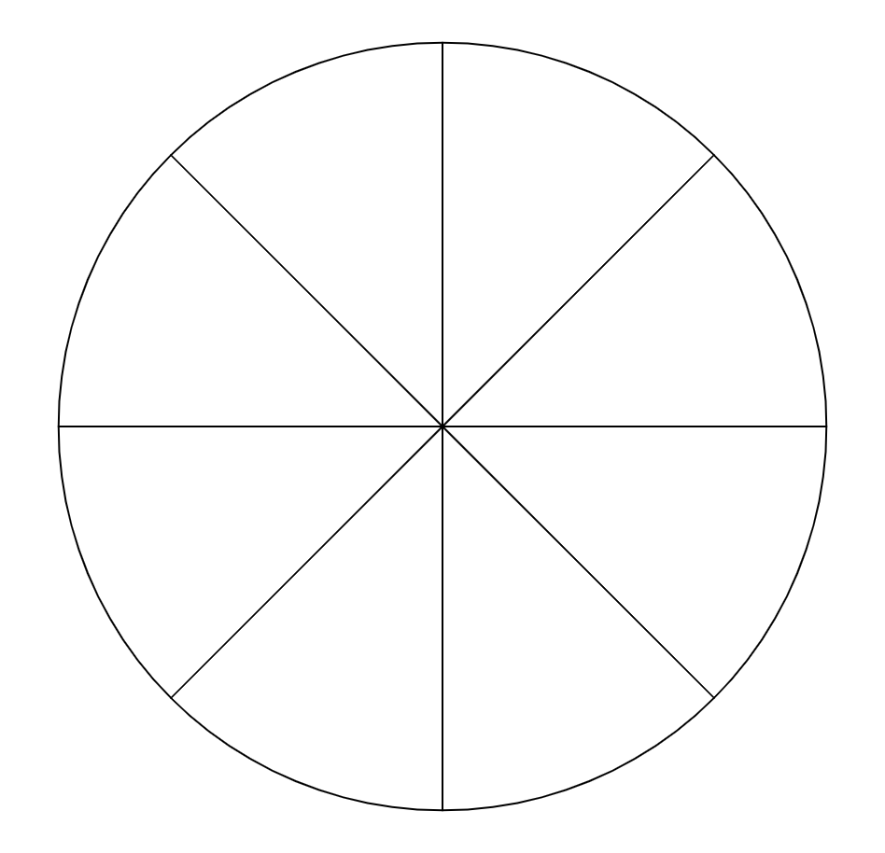
Constructing pie charts
Task A: Introduction to pie charts
1) Izzy collects data on whether there was air frost on 150 days between October and February.
The following table of results is represented in a pie chart.
Each sector of the pie chart represents 6 days worth of data. How many sectors should there be altogether?
air frost? | frequency
yes | 24
no | 126
150 ÷ 6 = 25 sectors
Sunshine over 2 hours? | frequency
yes | 135
no | 25
2) Aisha collects data on the number of days that had over 2 hours of sun per day on 160 days between April and September.
The following table of results is represented in a pie chart.
Aisha draws a pie chart. 27 sectors of her pie chart represent the number of days that did have over 2 hours of sunshine. How many sectors does Aisha’s pie chart have in total?
135 ÷ 27 = 5 days per sector
160 total days ÷ 5 = 32 total sectors
3) Alex collects data on the number of days in January (31 days) that had snowfall.
Alex wants to represent this data on a pie chart with 8 equal-sized sectors.
a) Explain why it is impossible for Alex to represent this data in a pie chart with 8 equal-sized sectors.
b) Explain whether it is possible for Alex to represent this data in a pie chart with any number of equal-sized sectors.
snowfall? | frequency
yes | 4
no | 27
31 ÷ 8 does not give an integer answer.
It is only possible if the pie chart is split into a multiple of 31 sectors.
‹#›

Slide 2
Constructing pie charts
Task B: Calculating angles for pie charts
1) Complete the calculations to represent these frequencies as angles on a pie chart.
360° ÷ 72 = 5°
weather | frequency | angles
sun | 37 | 185
cloud | 22 | 110
rain | 13 | 65
total | 72 | 360°
2) Complete the calculations to represent these frequencies as angles on a pie chart.
60
6
× 5
360° ÷ = .
meal | cost | angles
breakfast | 12 | 72
lunch | 23 | 138
dinner | 25 | 150
total | 60 | 360°
3) Complete the calculations to represent these frequencies as angles on a pie chart.
Hint: The multiplier is a non-integer.
6
× _____
weather | hours
sun | 40
cloud | 24
rain | 16
total | 80 | 360°
180
108
72
9
4.5
=
_
×
2
‹#›

Slide 3
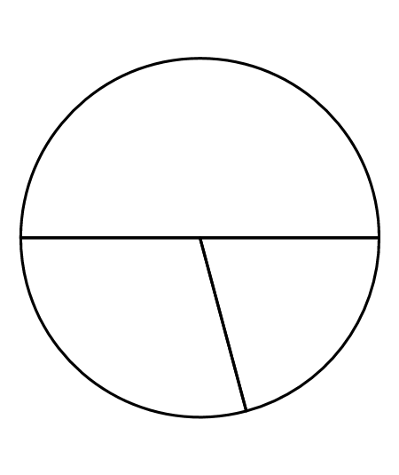
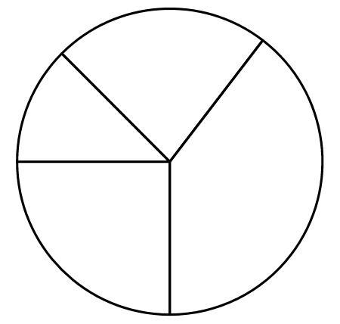
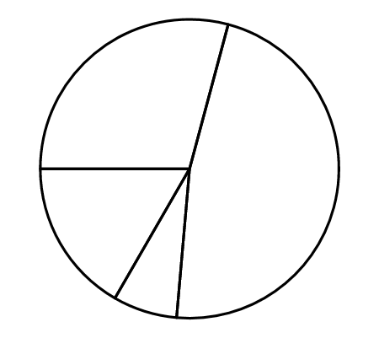
Constructing pie charts
Task C: Constructing pie charts
1) The table shows both the frequency and the angles required to represent the data on a pie chart.
The pie chart has been fully constructed, but not labelled.
Label each sector of the pie chart with the correct Key Stage.
2) The table shows both the angles required to represent this data on a pie chart.
Key Stage | Angle
Primary | 180°
Secondary | 75°
College | 105°
 | 360°
total
Construct this pie chart.
Key Stage | Frequency | Angle
KS1 | 72 | 45°
KS2 | 132 | 82.5°
KS3 | 228 | 142.5°
KS4 | 144 | 90°
 | 576 | 360°
Primary
total
College
Secondary
KS2
KS1
KS3
KS4
3) The table shows both the frequency and most of the angles required to represent the data on a pie chart.
Construct this pie chart.
Trainers
Footwear | Frequency | Angle
Trainers | 42 | 105°
Boots | 68 | 170°
Flip-Flops | 10 | 25°
Other | 24 | 60°
 | 144 | 360°
Other
Boots
Flip-Flops
Mathematics in Education and Industry.
v2.2

